Slide 1



Problem Statement Solution Submission
PROBLEM STATEMENT SOLUTION SUBMISSION
USING A PYTHON PROGRAM
TO CREATE A
LIST OF SOFTWARE
APPLICATION DETAILS.
BY,
S.BUVANESHWARAN
DEPARTMENT OF ECE
ERODE SENGUNTHAR ENGINEERING COLLEGE

Slide 2
CONTENT
Problem statement
Software Used
Algorithm
Explanation
Sample input
Sample output

Slide 3
PROBLEM STATEMENT
Write a python program to create a list of software application details. The details of application include name, author, version, publishing year , price.
Perform the following with respect to the list of application created.
a) Display all the details of application by a given author.
b) Sort the details of application in the increasing order of price.
c) Display the details of applications published by a given publisher in a given year.
d) Sort the list of applications in the increasing order of two fields , author and publishing year of the books.

Slide 4

SOFTWARE USED
Python Programming
Language

Slide 5
ALGORITHM
•STEP 1 :Start
•STEP 2 : Get the input variables to perform the regarding operation
•STEP 3 :Write the displaying statement for choosing the required condition.
•STEP 4 :Under the 1st choice, the user input author name will be compared with the entered application.
STEP 5: Under the 2nd choice, sorting process takes place to sort the cost of books.

Slide 6
STEP 6: In the choice 3 , the author name and the publishing year will be got as user input and then regarding details will be printed.
STEP 7: The author name will be got as input in the choice 4 and the regarding details will be printed.
STEP 8 : In choice 5 , the program is set to exit.
STEP 9 : Stop.

Slide 7
EXPLAINATION
STEP 1
Initialize the three variable I, j and k are assigned with values 0, 1 and 1 respectively.

Slide 8
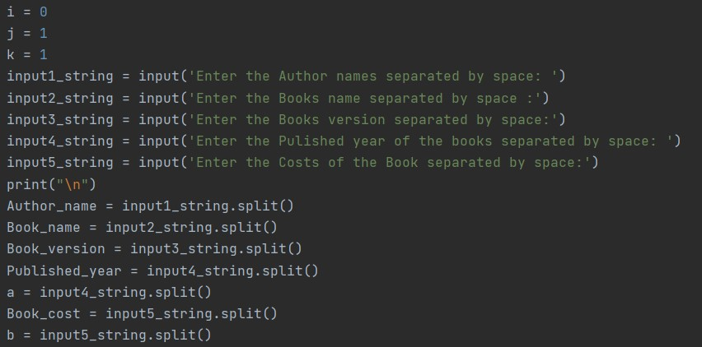
STEP 2
Get the input and store
the list of inputs in the
corresponding lists

Slide 9
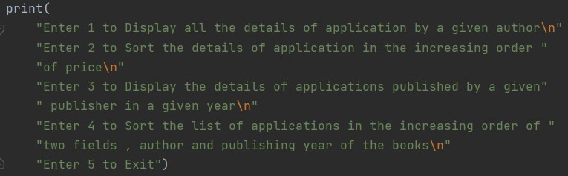
STEP 3
Initialize the
dictionaries
With corresponding
lists.

Slide 10
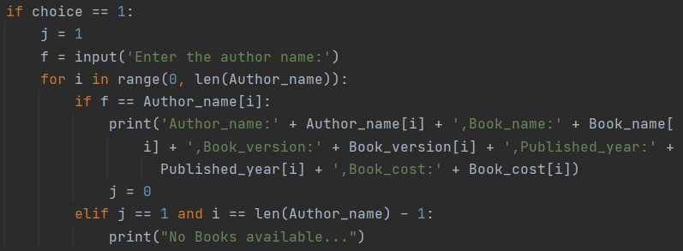
STEP 4
In choice 1 , author's name is
taken as the input. It'll display the details of the book if it is present in the list. Otherwise it'll show no books are available.

Slide 11
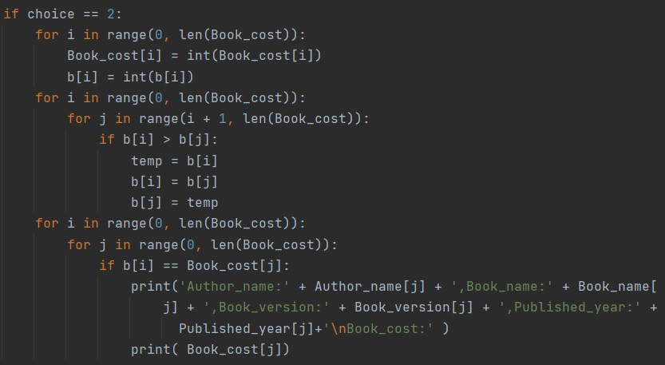
STEP 5
In the choice 2 , it'll display
The details of the book in the increasing order of price.

Slide 12
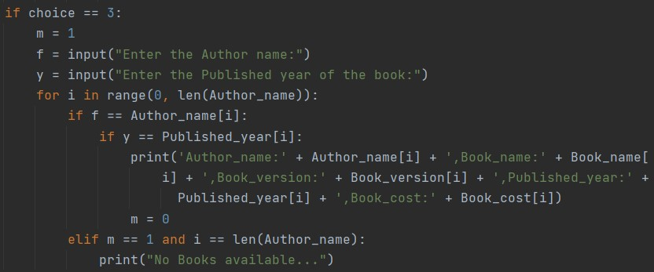
STEP 6
In the choice 3 , an input value of author's name and the published year of the book is taken and then it'll display the corresponding books details if it is present in the list otherwise, it'll display no books are available

Slide 13
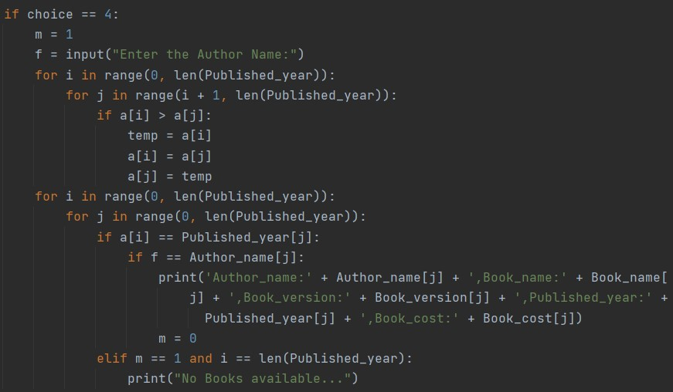
STEP 7
In choice 4 , an input of author name is taken . It'll check whether it is present in the corresponding list according to that it'll display the book details in the increasing order of published year of the book. Otherwise it'll show no books are available

Slide 14

STEP 8
If the choice is 5 , it'll exit the program.

Slide 15
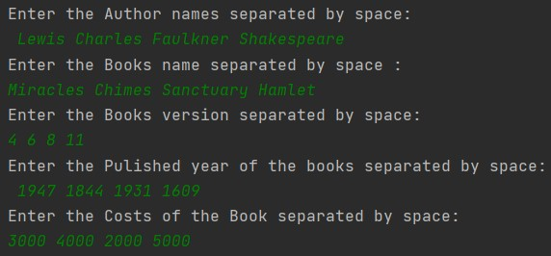
SAMPLE INPUT

Slide 16
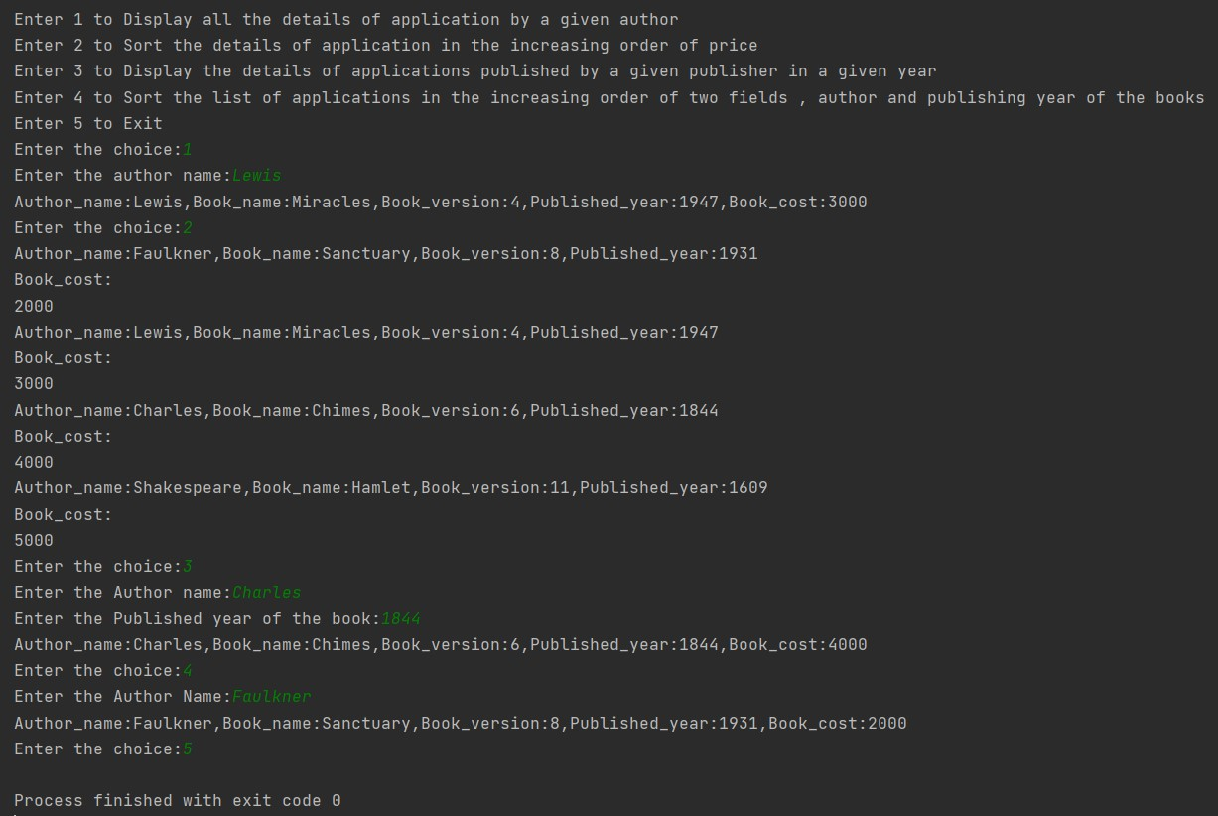
SAMPLE OUTPUT

Slide 17
THANK YOU

